Slide 1
Marie Schumann Personius
This is Your Life
6 Nov 1913 - 28 Mach 2009
93 Years Old

Slide 2
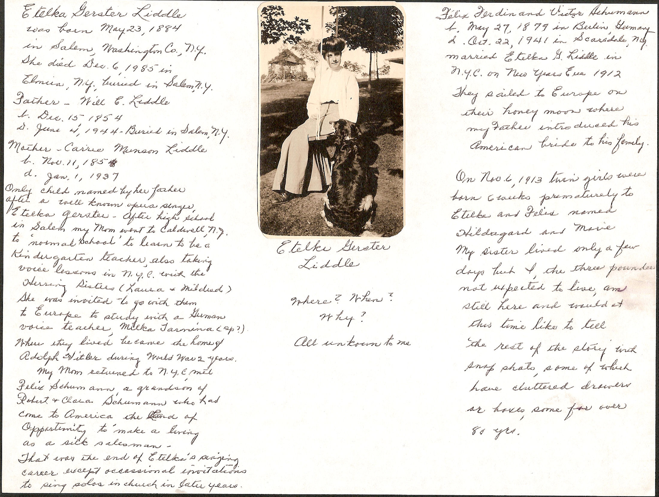
Notes:
Left Column
Etelka Gerster Liddle was born May 23, 1884 in Salem, Washington County, New York. She died December 6, 1985 in Elmira New York and is buried in Salem, New York.
Father – Will E. Liddle born November 11, 1854. Died June 4, 1944 Buried in Salem, New York
Mother – Carrie Munson Liddle Born November 11, 1854 Died January 1, 1937.
Only child named by her father after a well-know opera singer, Etelka Gerster. After high school in Salem my Mom went to Caldwell, New York to “normal school” to learn to be a kindergarten teacher also taking voice lessons in NYC with the Herring Sisters (Laura & Matilda). She was invited to go with them to study a German voice teacher, Milka Tarmina (sp?) Where they lived became the home of Adolf Hitler during WWII. My Mom returned to NYC with Felix Schumann, a grandson of Robert and Clara Schumann who had come to America, the land of opportunity to make a living as a silk salesman. That was the end of Etelka’s singing career except for occasional invitations to sing solos in church in later years.
Right Column
Felix Ferdinand and Victor Schumann
Born May 27, 1879 in Berlin Germany Died October 22 1941 in Scarsdale, NY
Married Etelka G. Liddle in NYC on New Years Eve 1912
They sailed to Europe on their honeymoon where my father introduced his American bride to his family.
On November 6, 1913 twin girls were born 6 weeks prematurely to Etelka and Felix named Hildegard and Marie. My sister lived only a few days but I, the three pounder not expected to live, am still here and would at this time like to tell the rest of the story with snapshots, some of which have cluttered drawers or boxes some for over 80 years.

Slide 3
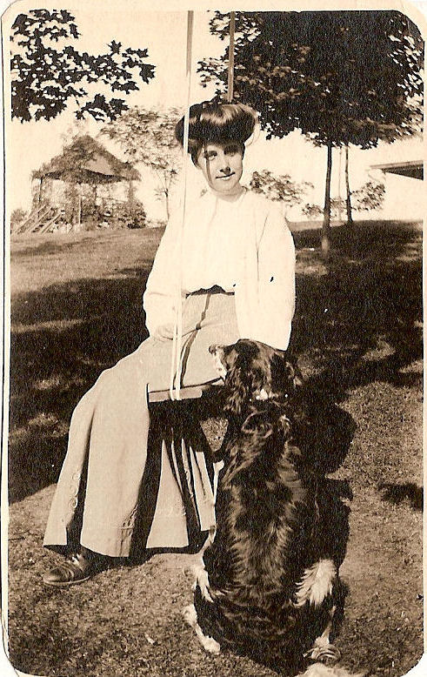

Slide 4
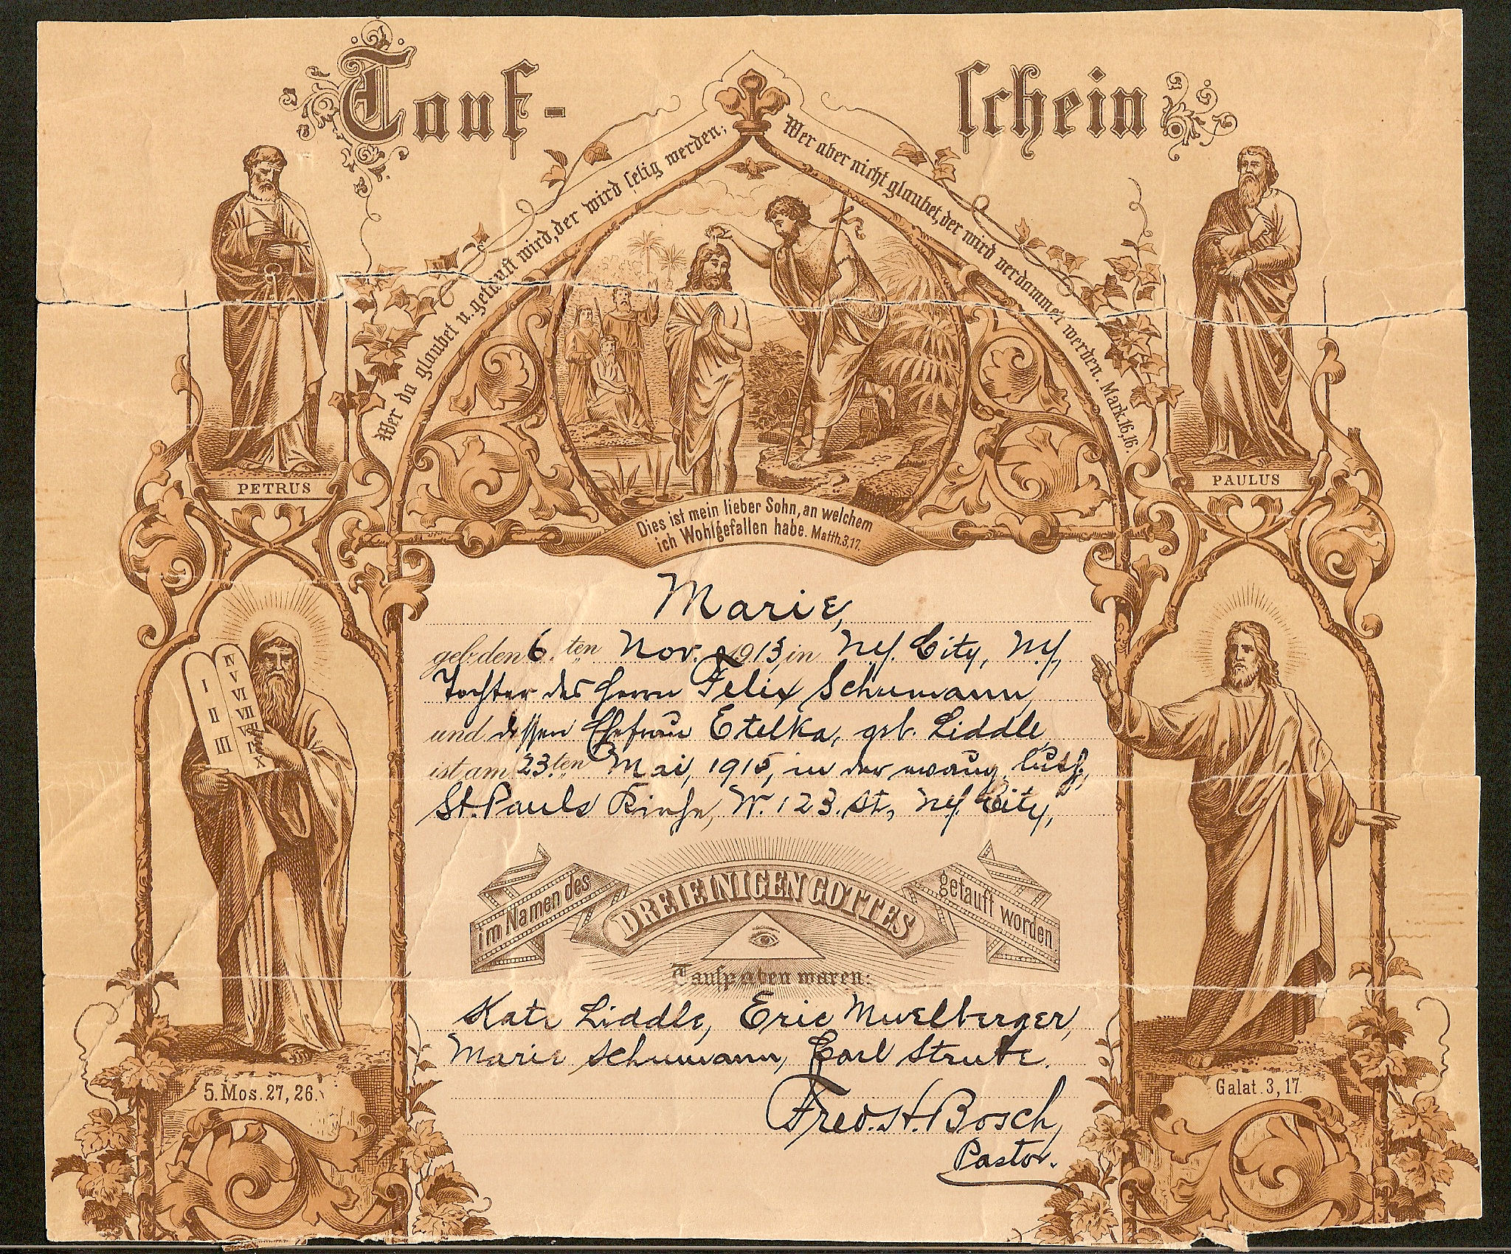

Slide 5
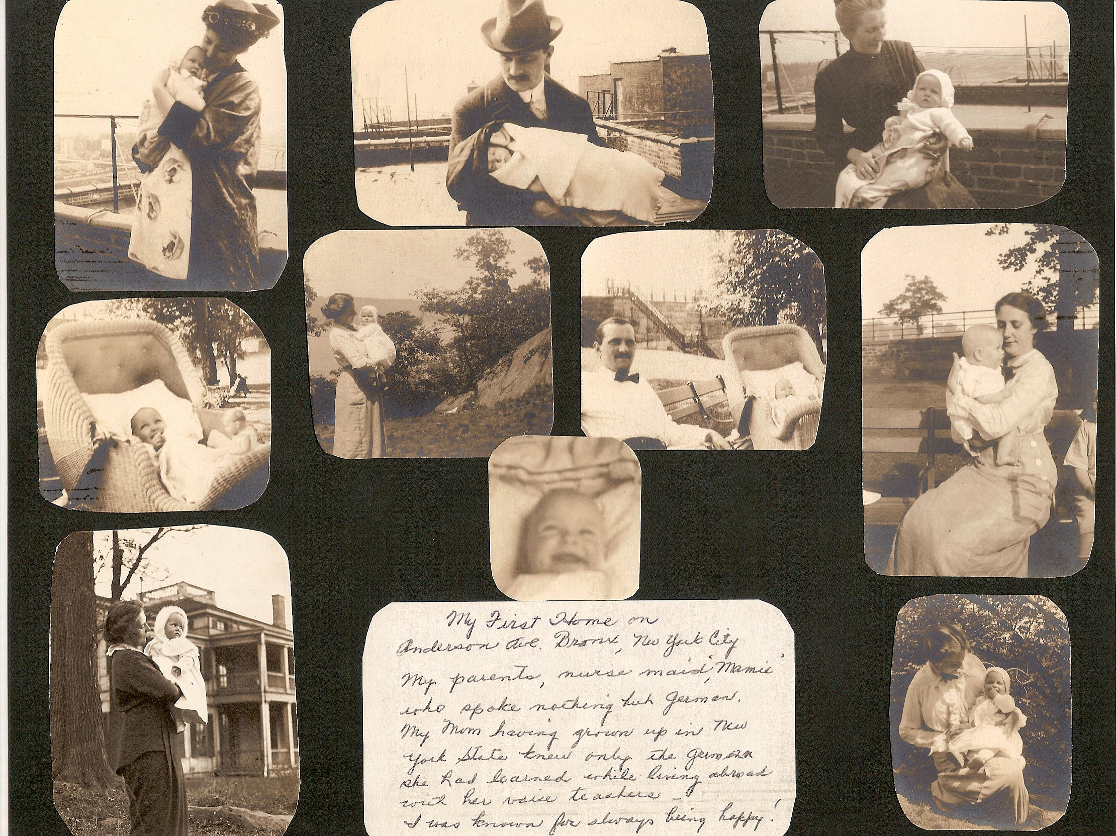
Notes:
My First Home on Anderson Avenue in the Bronx, New York City. My Parents, nurse maid Mamie who spoke nothing but German. My Mom having grown up in the New York State knew only the German she had learned while living abroad with her voice teacher. I was known for always being happy!

Slide 6
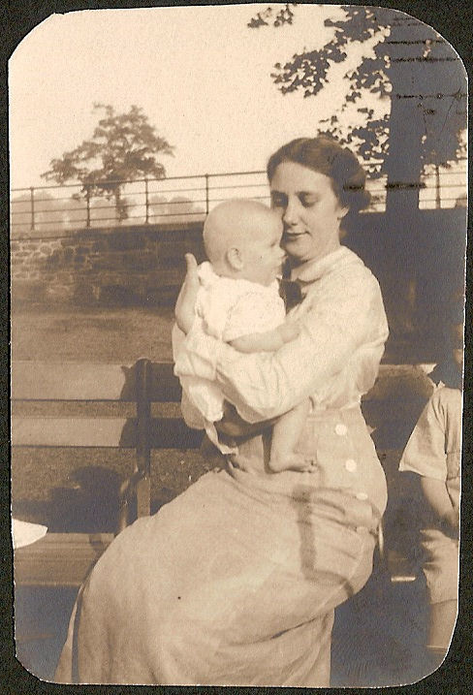
Marie and Mom (Etelka)

Slide 7
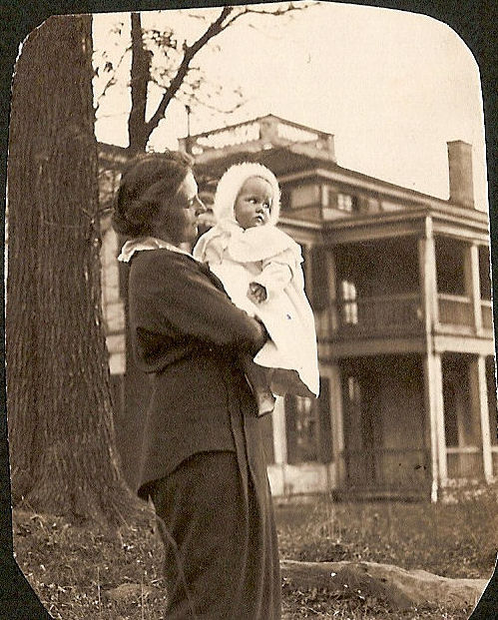
Marie and Mom (Etelka)

Slide 8
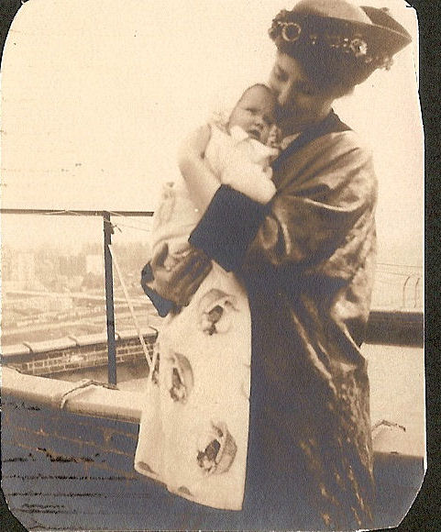

Slide 9
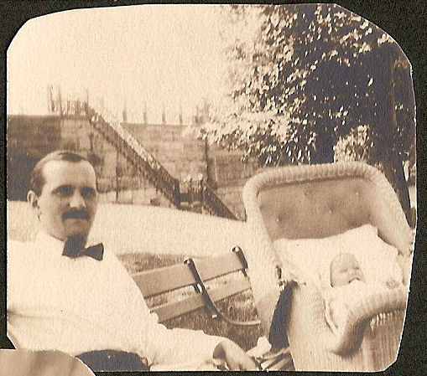

Slide 10
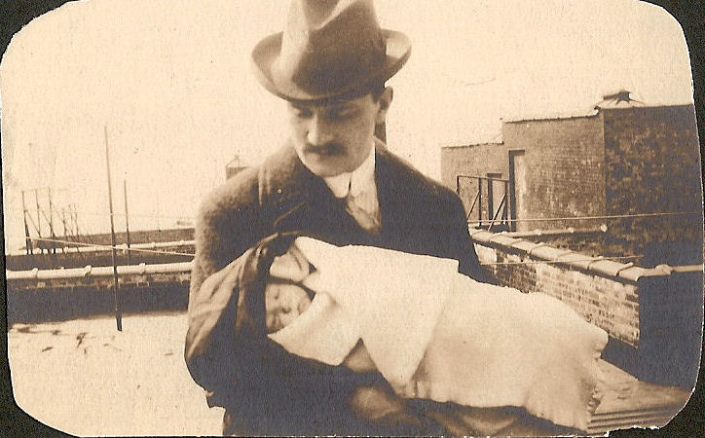

Slide 11
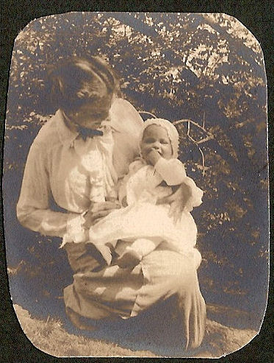

Slide 12
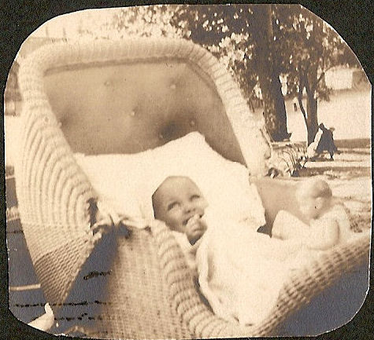

Slide 13
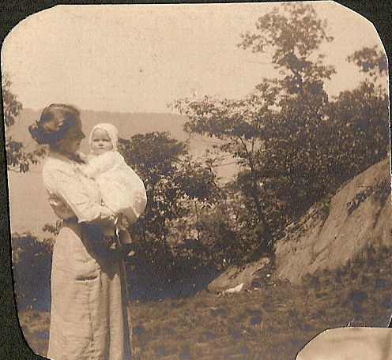

Slide 14
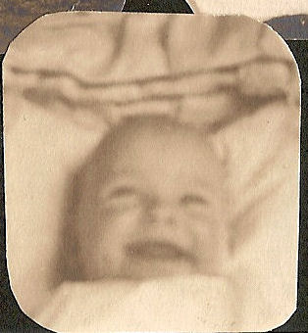

Slide 15
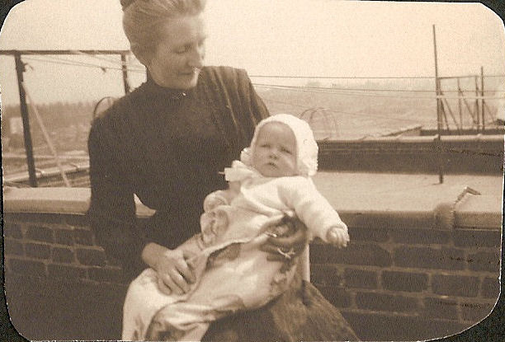
Mamie Governess and Marie Schumann/Personius

Slide 16
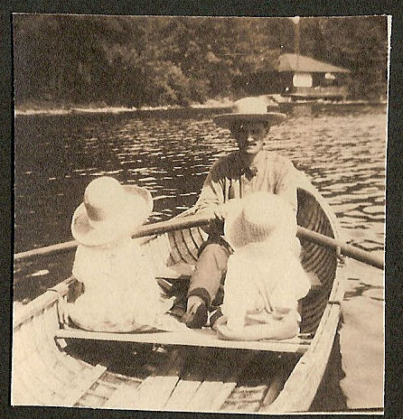
Daddy Schumann and under hats… Walt and Marie

Slide 17
Etelka Schumann and Daughter Marie Schumann Personius

Slide 18
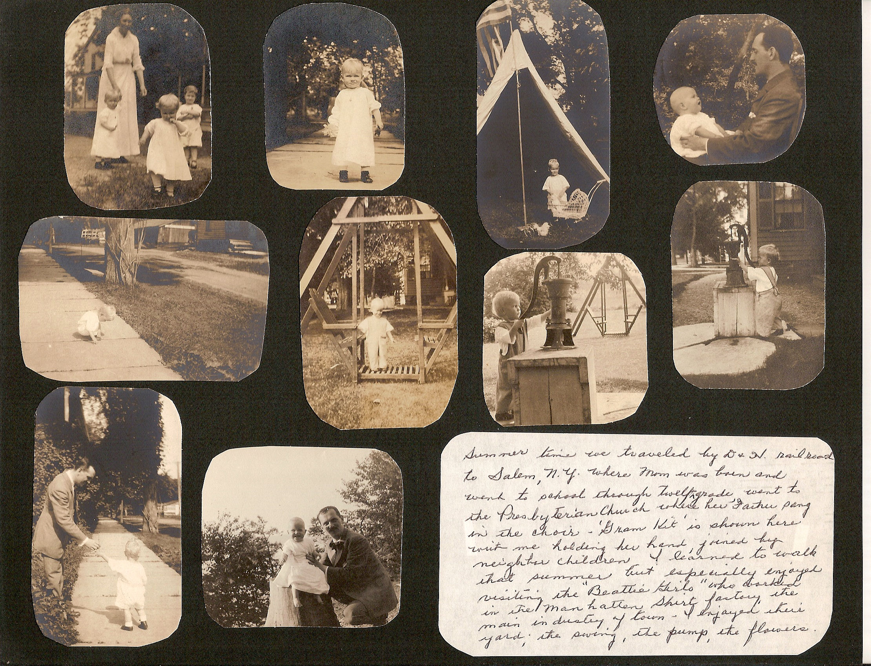
Marie Schumann Personius

Slide 19
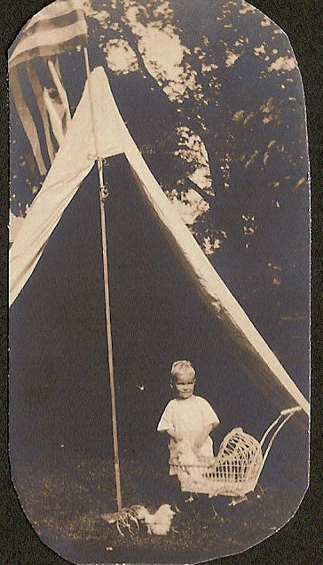
Marie Schumann/Personius

Slide 20
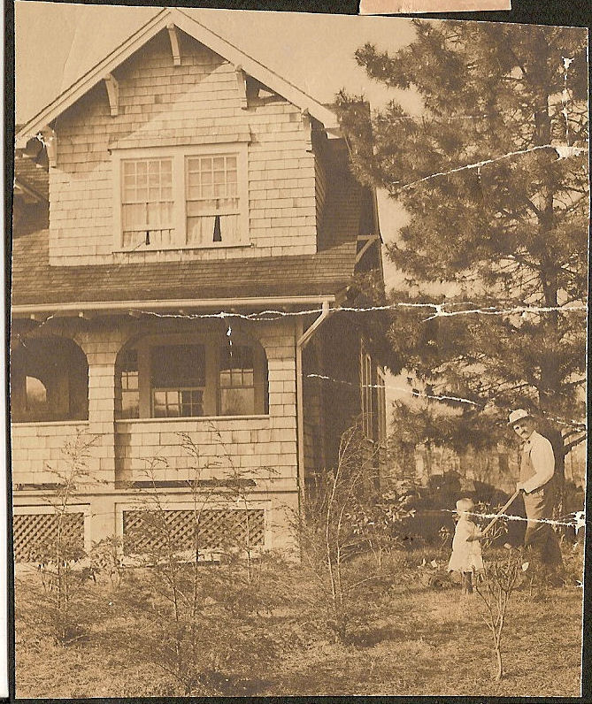

Slide 21
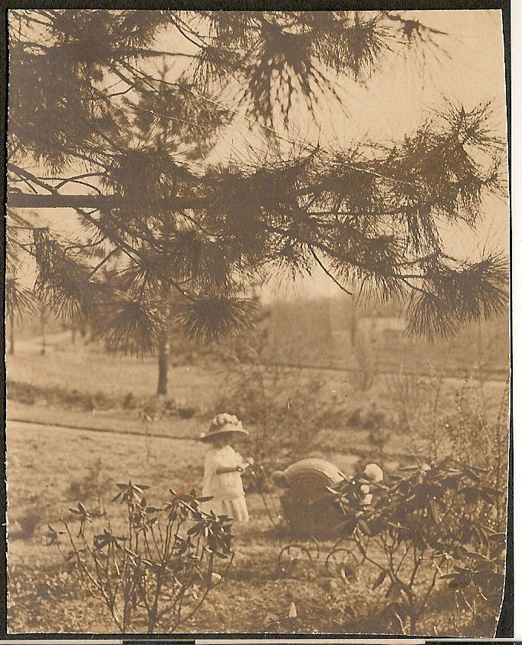
Marie Schumann/Personius

Slide 22
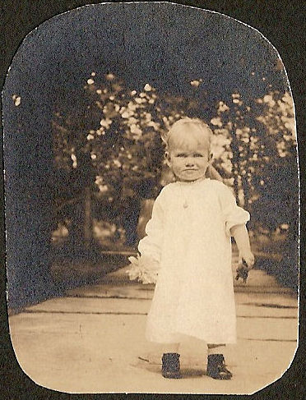

Slide 23
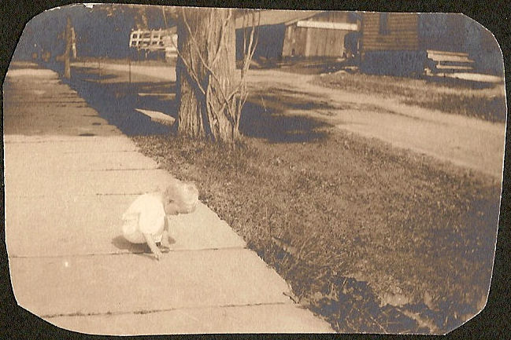

Slide 24
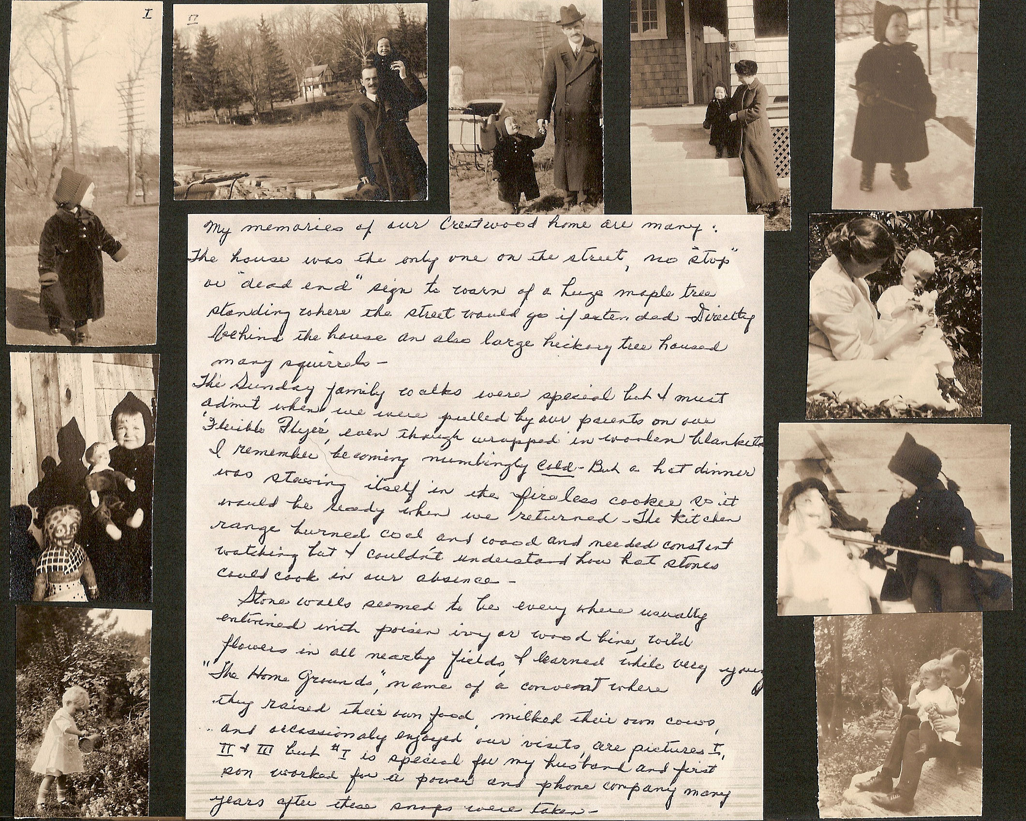
Notes:
My memories of our Crestwood home are many:
The house was the only one on the street, no “stop” or “dead end” sign to warn of a huge maple tree standing where the street would go if extended directly behind the house an also large hickory tree housed many squirrels.
The Sunday family walks were special but I must admit when we were pulled by our parents on our “Flexible Flyers” even though wrapped in woolen blankets. I remember becoming numbingly cold – but a hot dinner was steaming itself in the fireless cooker so it would be ready when we retuned. The kitchen range burned coal and wood and needed constant watching but I couldn’t understand how hot stones could cook in our absence.
Stone walls seemed to be everywhere usually entwined with poison ivy or wood bine, wild flowers in all nearby fields. I learned while very young “The Home Grounds” name of a convent where they raised their own food, milked their own cows, and occasionally enjoyed our visits, are pictures I, II & III but #I is special for my husband and first son worked for a power and phone company many years after these snaps were taken.

Slide 25
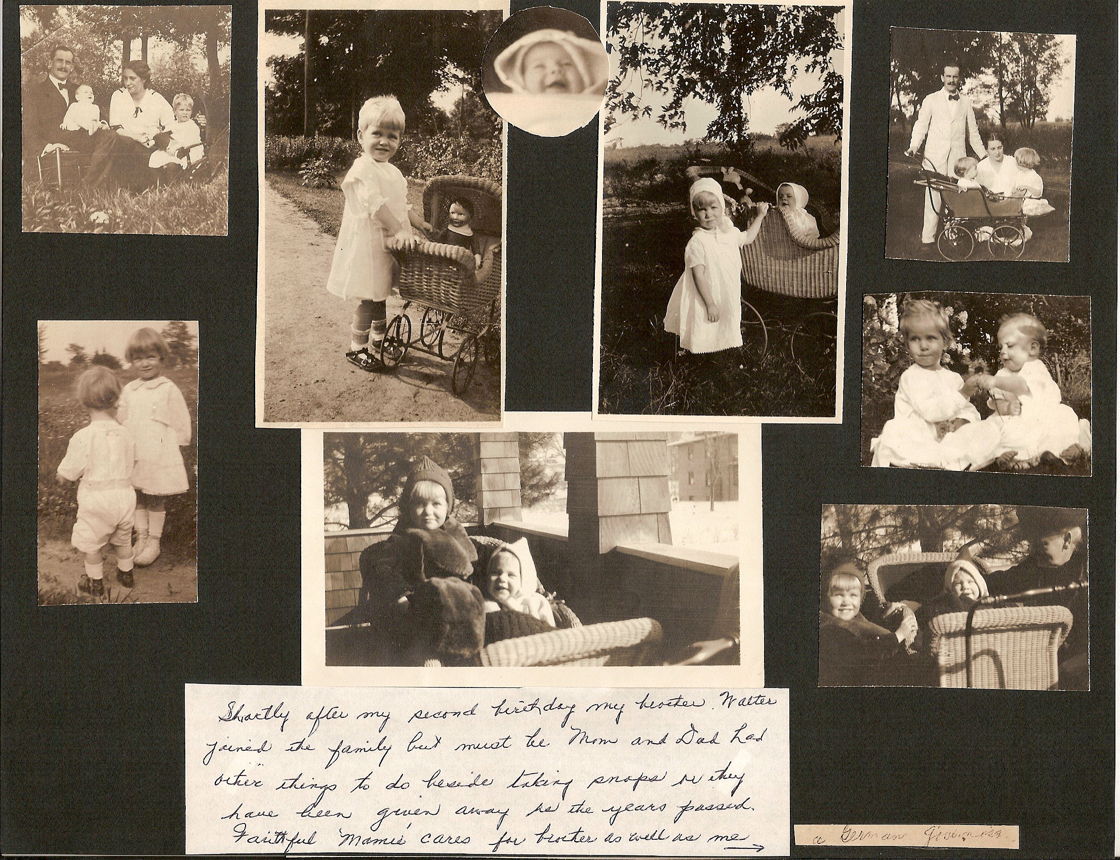
Notes:
Shortly after my second birthday my brother Walter joined the family but must be Mom and Dad had other things to do beside taking snaps or they have been given away as the years passed. Faithful Mamie cares for brother as well as me.

Slide 26
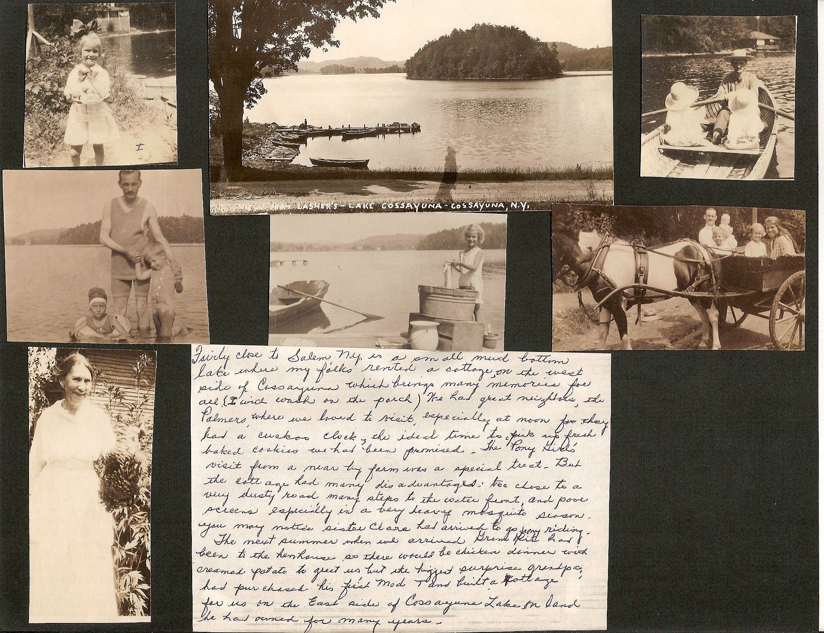
Notes:
Fairly close to Salem, NY is a small mud bottom lake where my folks rented a cottage on the west side of Cossayuna which brings many memories of all.
(I would wash on the porch). We had great neighbors, the Palmers, where we loved to visit, especially at noon for they had a cuckoo clock and the ideal time to pick up fresh baked cookies we had been promised. The “Pony girls” visit from a near by farm was a special treat. But the cottage had many disadvantages: too close to a very dusty road, many steps to the water front, and poor screens especially in very mosquito season. You may notice sister Clare had arrived to go pony riding.
The next summer when we arrived Grama Kit had been to the henhouse so there would be chicken dinner with creamed potatoes to greet us but the biggest surprise grandpa had purchased his first Model T and built a cottage for us on the East side of Cassayuna Lake on land he had owned for many years.

Slide 27
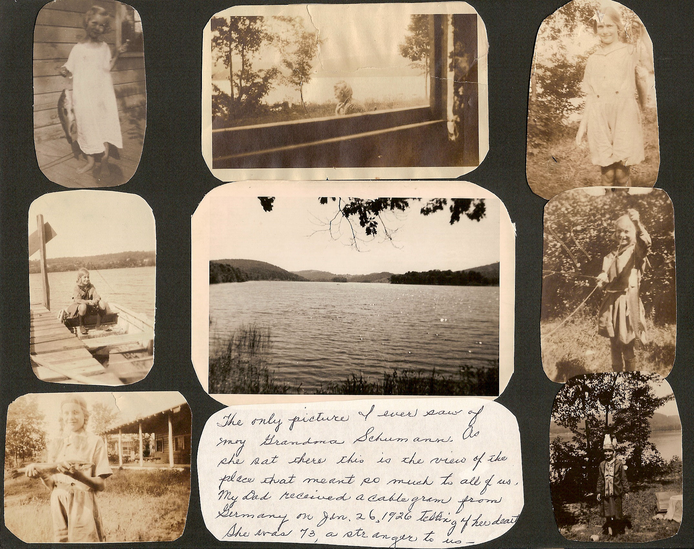
Notes:
The only pictures I ever saw of my Grandma Schumann. As she sat there this is the view of the place that eant so much to all of us. My Dad received a cable gram from Germany on Jan 26 1926 telling of her death. She was 73, a stranger to us

Slide 28
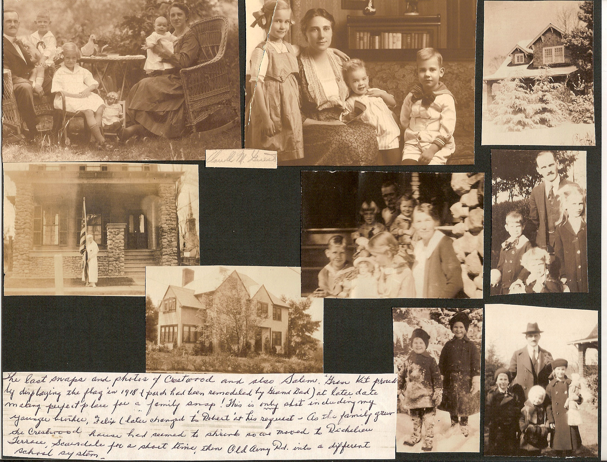
Notes:
The last snaps and photos of Crestwood amd also Salem. Gram Kit probably displaying the flag in 1918 (porch had been remodeled by Grand Dad) at later date making perfect place for a family snap! This is only shot including my younger brother Felix (later changed to “Robert” at his request.) As the family grew the Crestwood house had seemed to shrink so we moved to Richelieu Terrace, Scarsdale for a short time, then Old Army Rd. into a different school system.

Slide 29
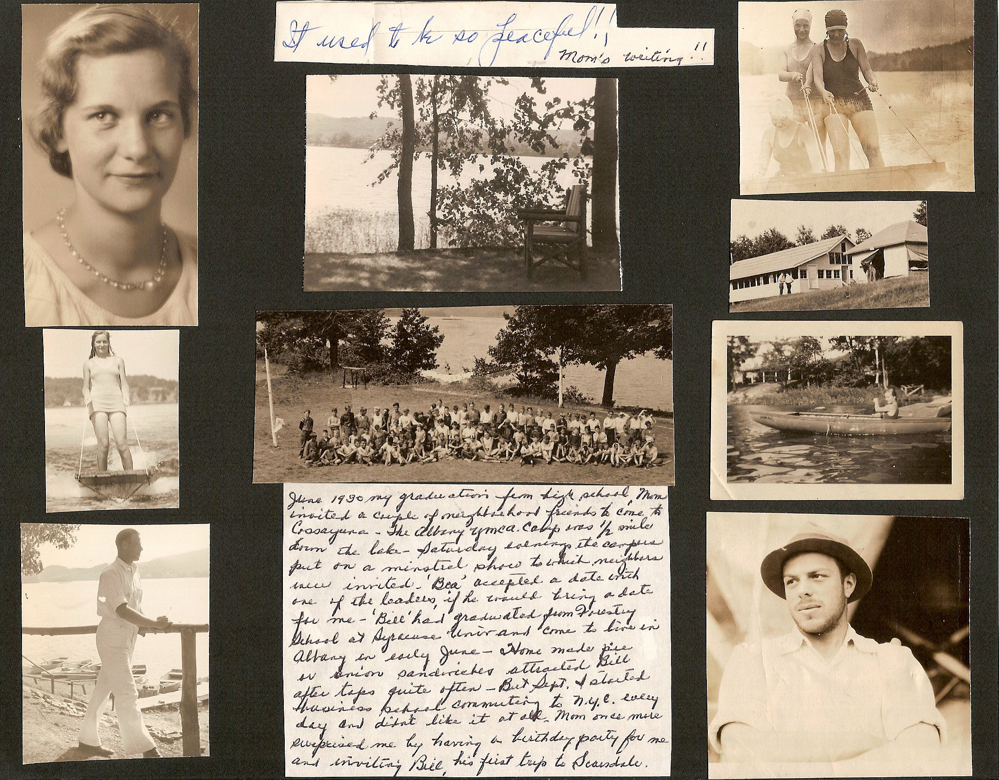
Notes:
June 1930 my graduation from high school. Mom invited a couple of neighborhood friends to come to Cassayuna. The Albany YMCA Camp was ½ mile down the lake. Saturday evenings the campers put on minstrel sow to which neighbors were invited. “Bea” accepted a date with one of the leaders, if he would bring a date for me. Bill had graduated from Forestry School at Syracuse Univ and came to live in Albany in early June. Home made pie or onion sandwiches attracted Bill after taps quite often. But Sept. I started business school commuting to N.Y.C every day and didn’t like it at all. Mom once more surprised me by having a birthday party for me and inviting Bill for his first trip to Scarsdale.

Slide 30
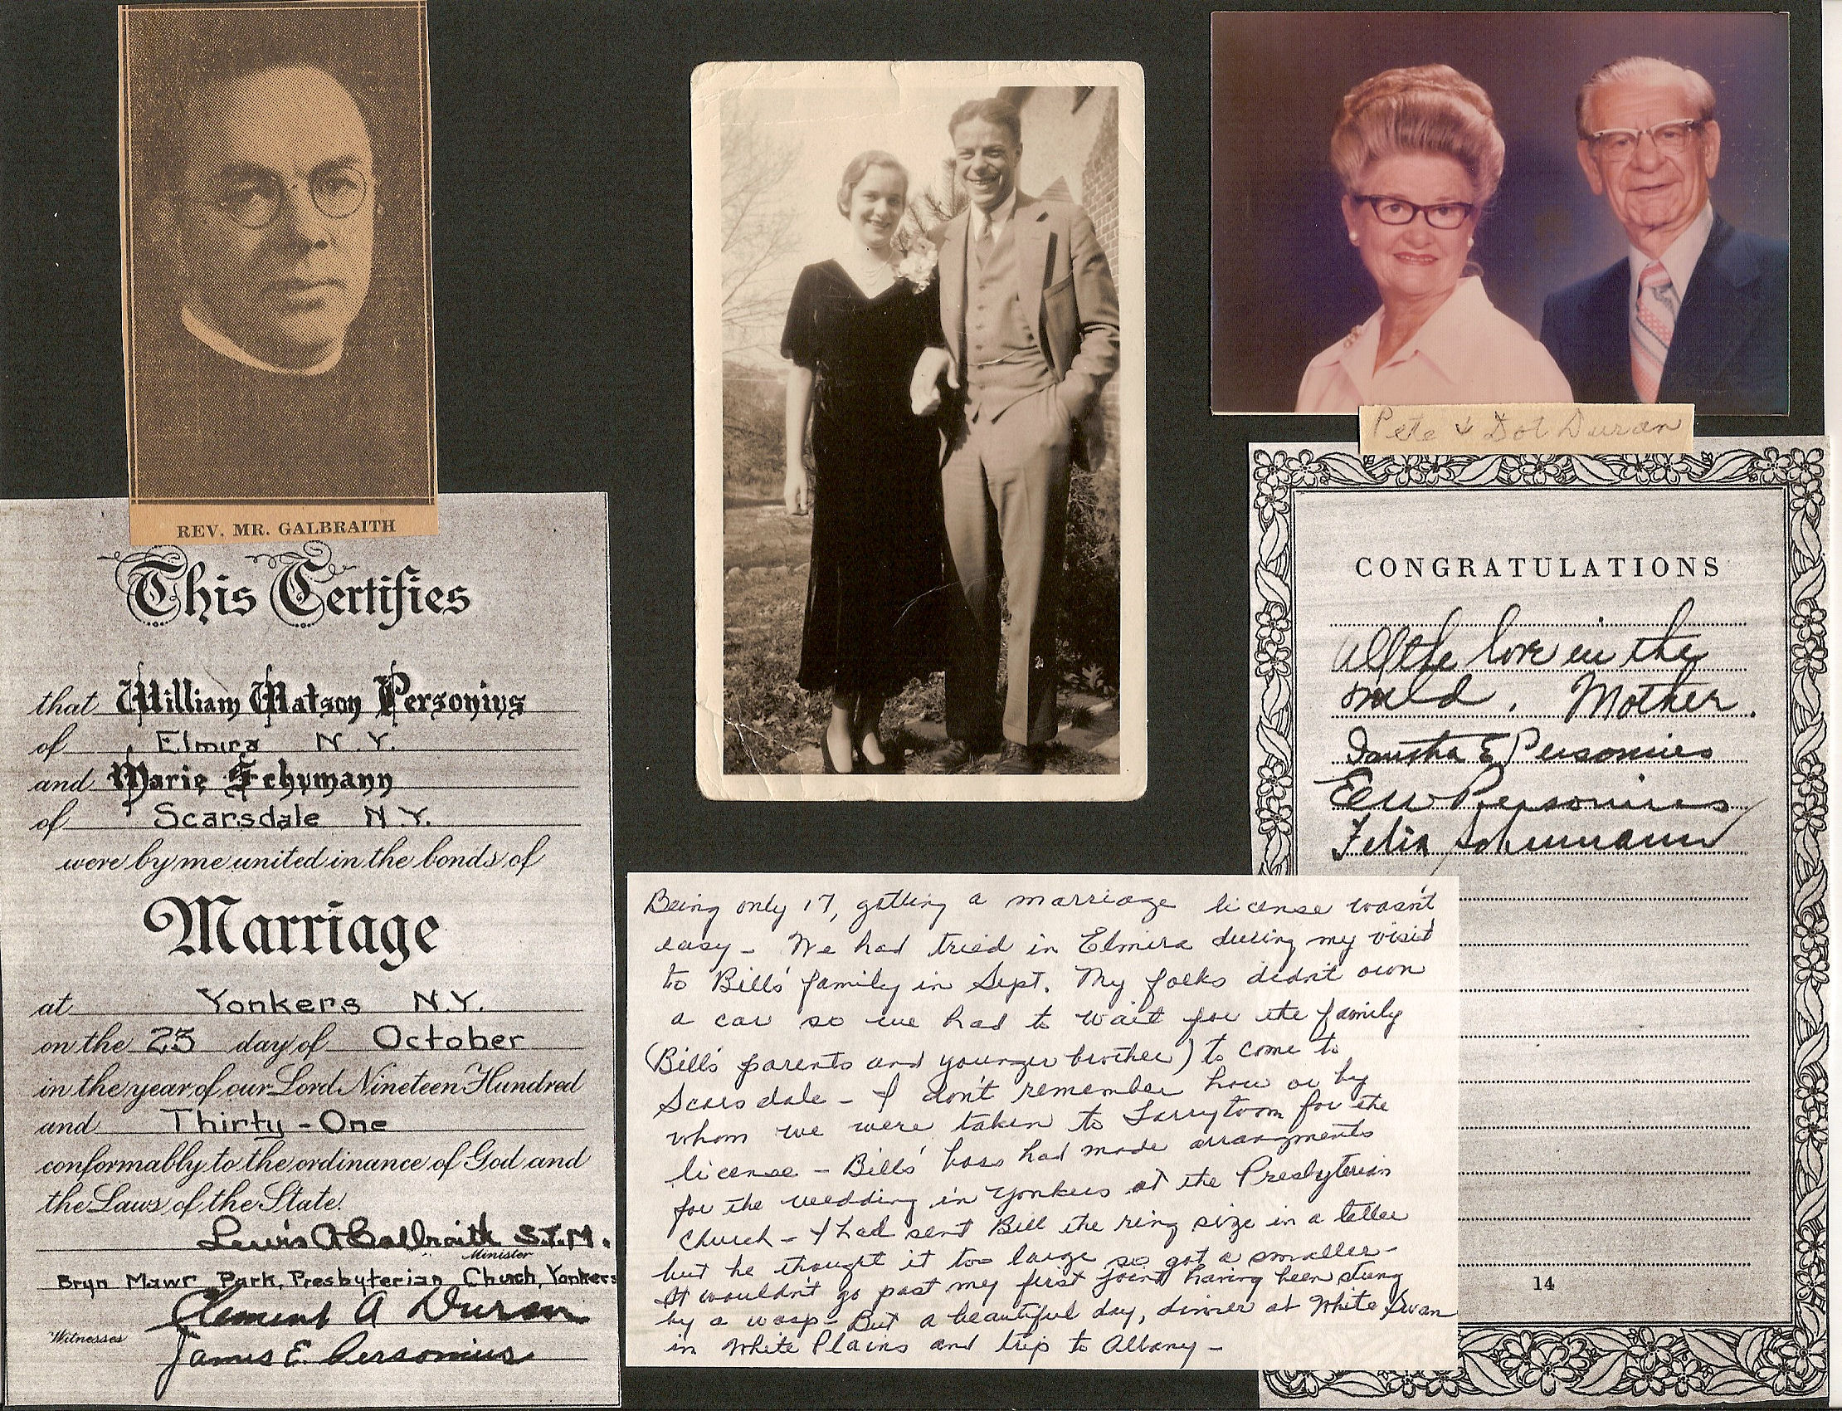
Notes:
Being only 17 getting a marriage license wasn’t easy. We had tried in Elmira during my visit to Bill’s family in Sept. My folks didn’t own a car so we had to wait for the family (Bill’s parents and younger brother) to come to Scarsdale. I don’t remember how or by whom we were taken to Tarrytown for the license – Bill’s boss had made arrangements for the wedding in Yonkers at the Presbyterian Church. I had sent Bill the ring size in a letter but he thought it too large so got a smaller . It wouldn't go past my first joint having been stung by a wasp but a beautiful day, dinner at White Swan in White Plains and trip to Albany.

Slide 31
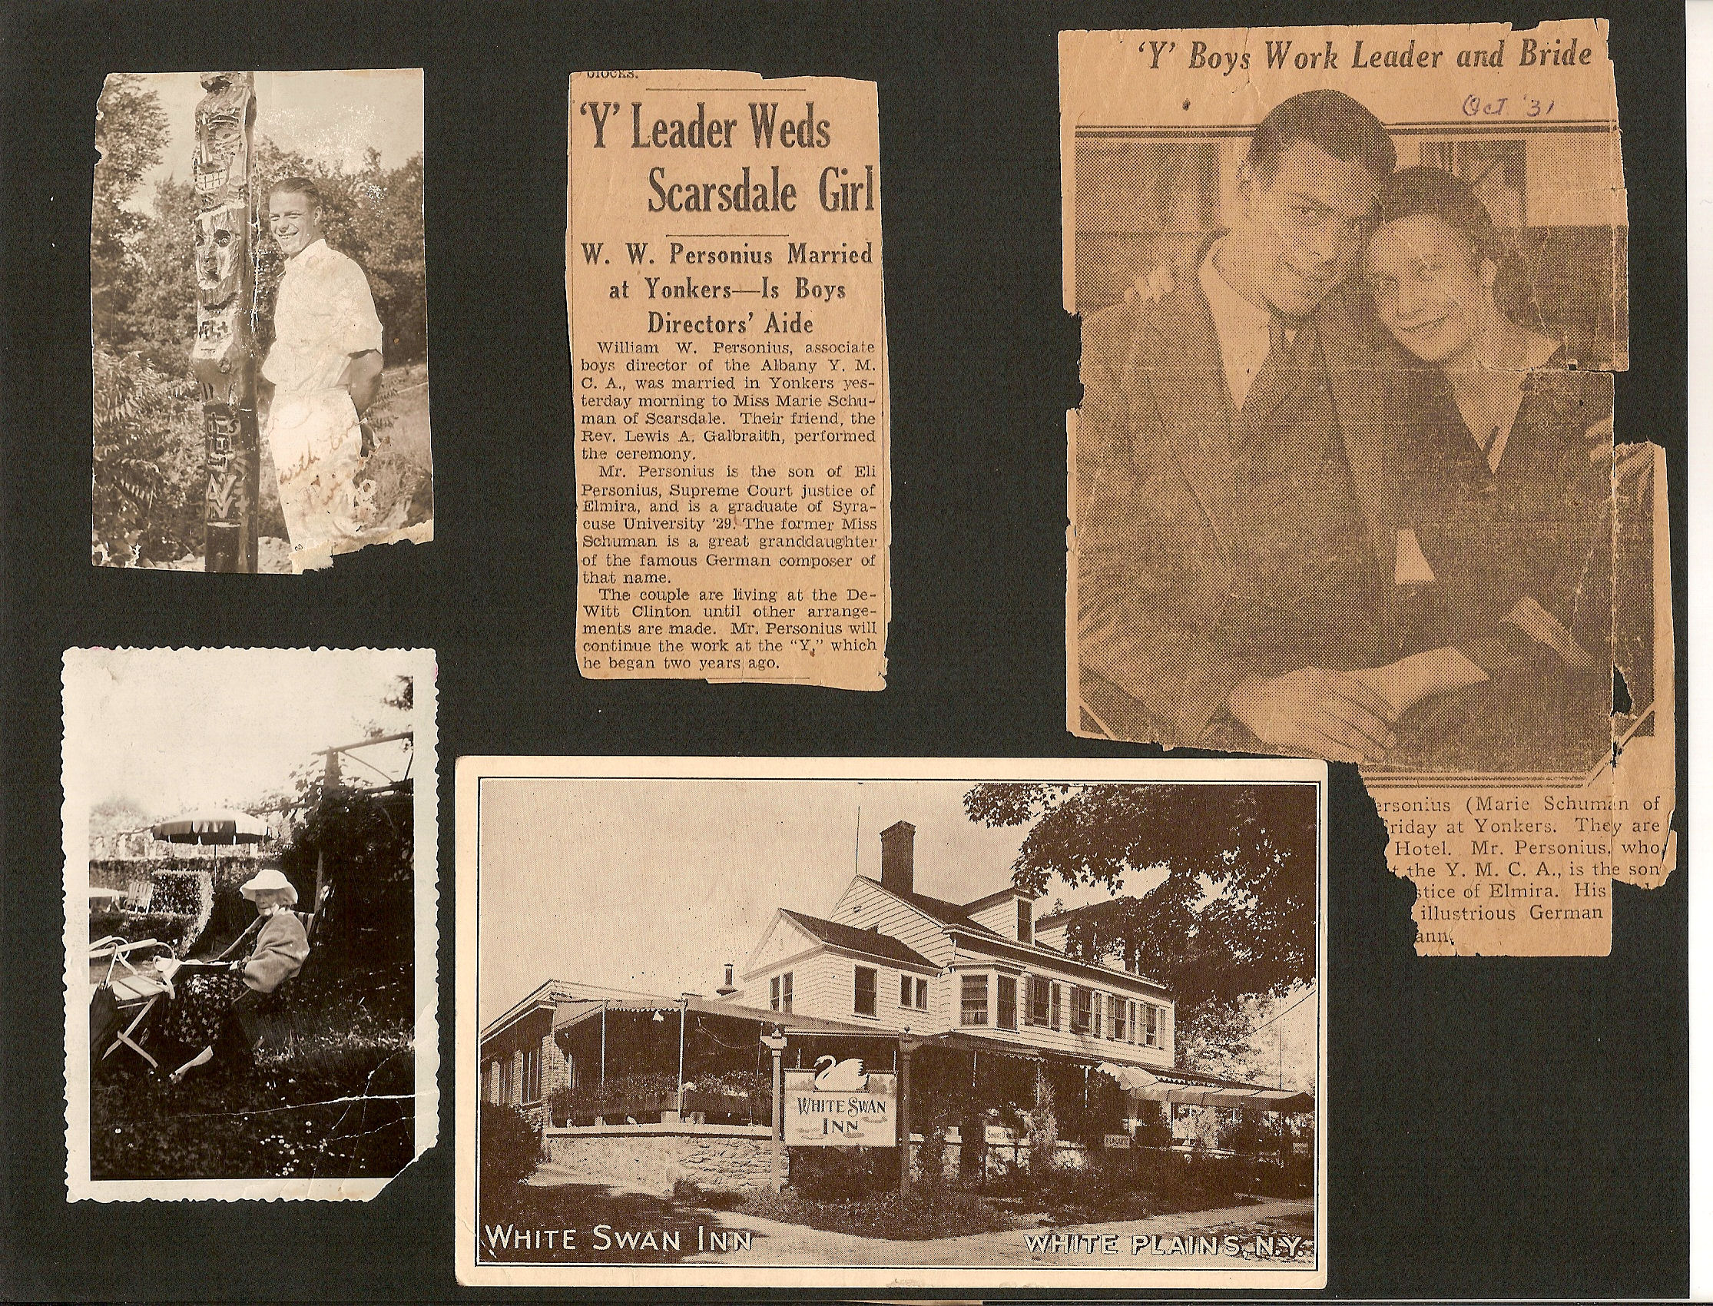

Slide 32
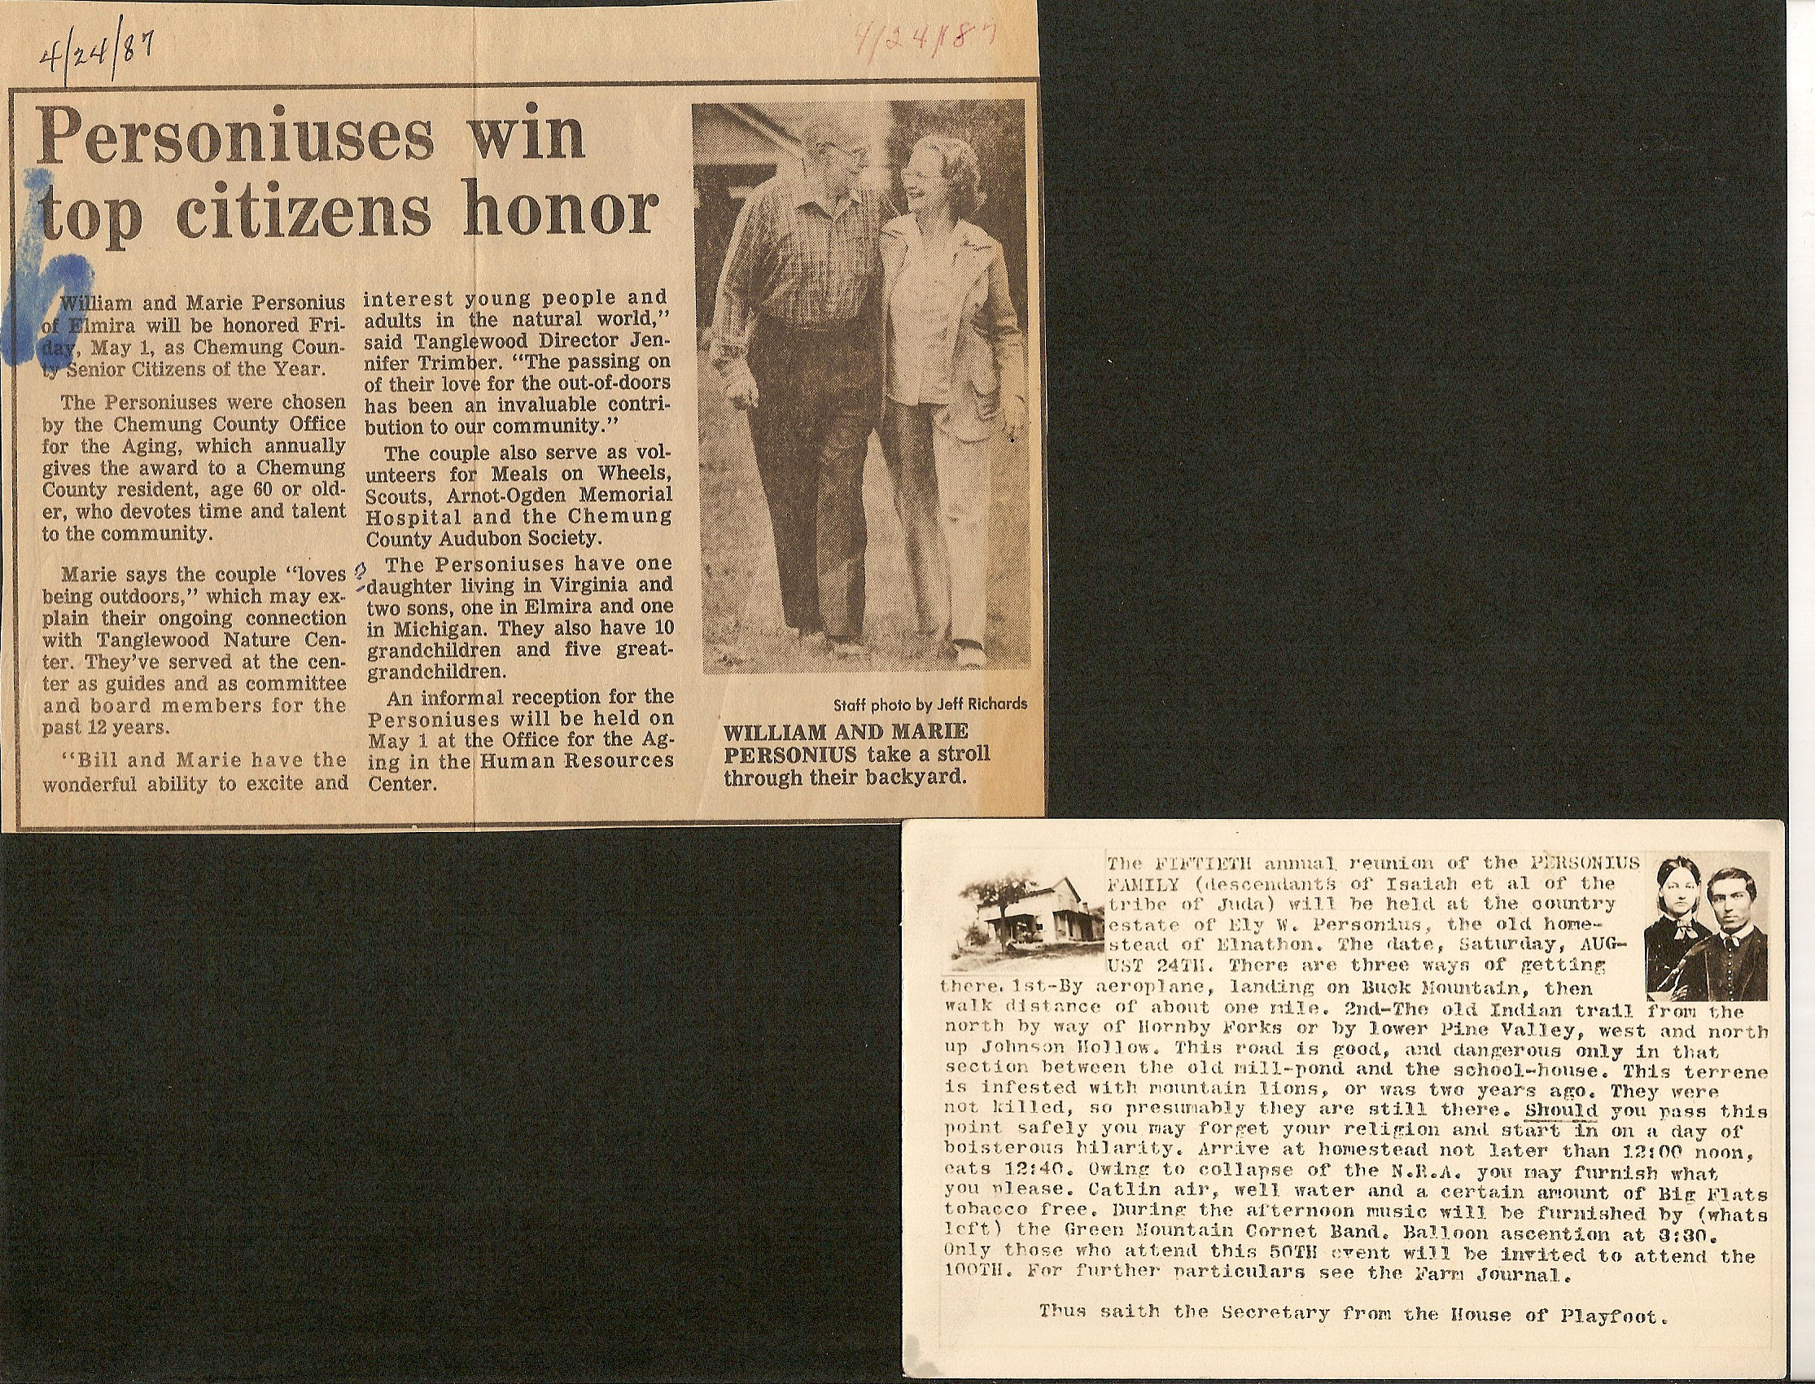

Slide 33
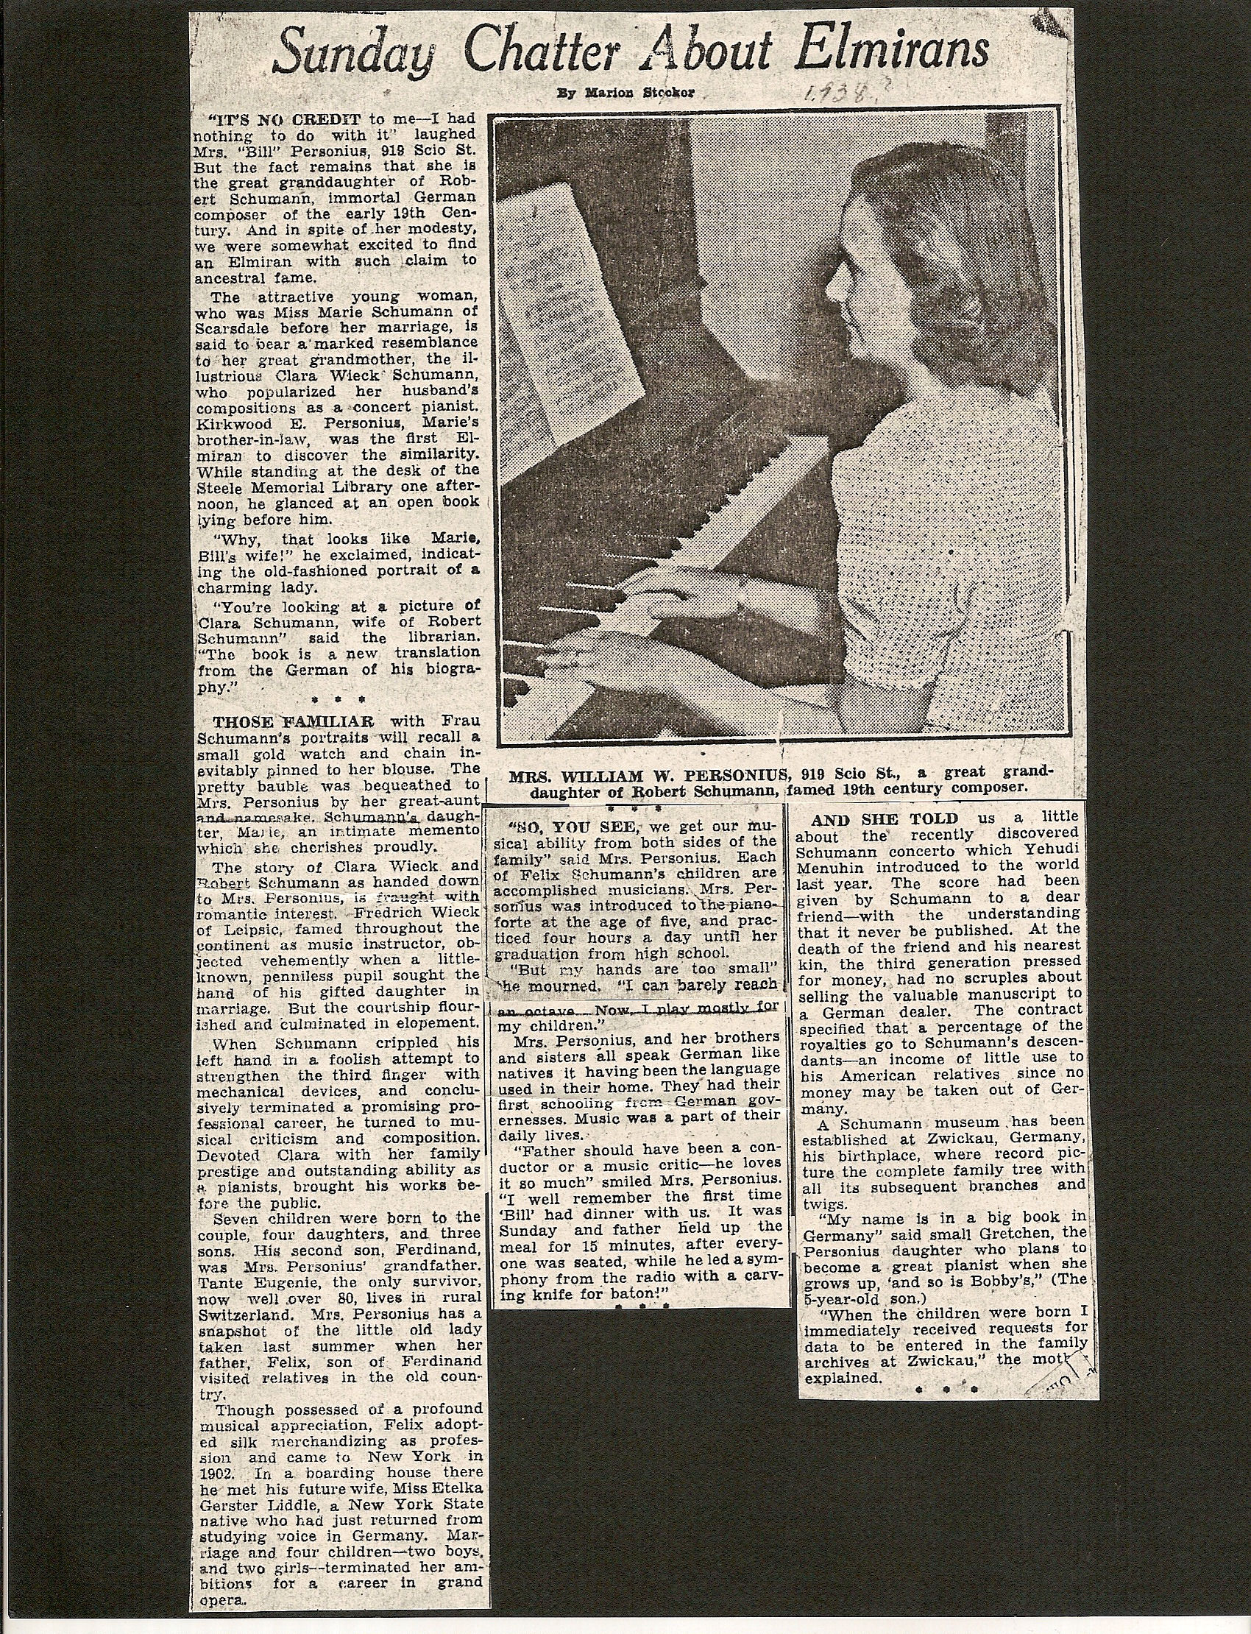

Slide 34
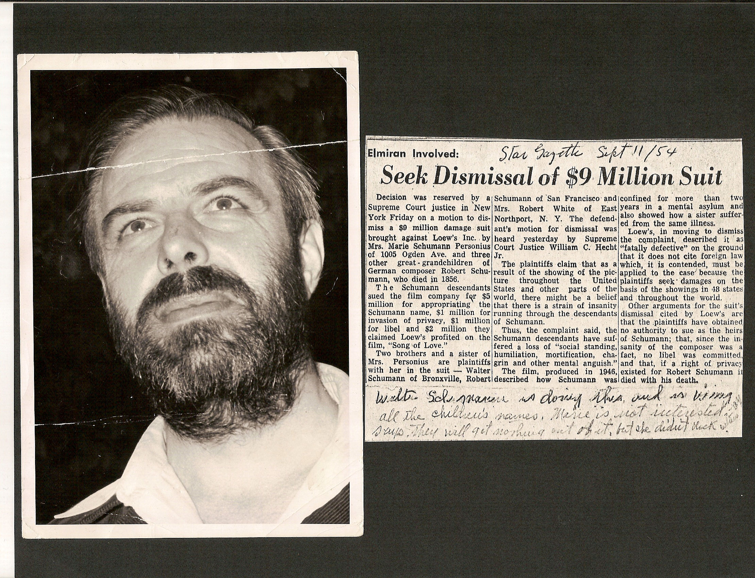

Slide 35
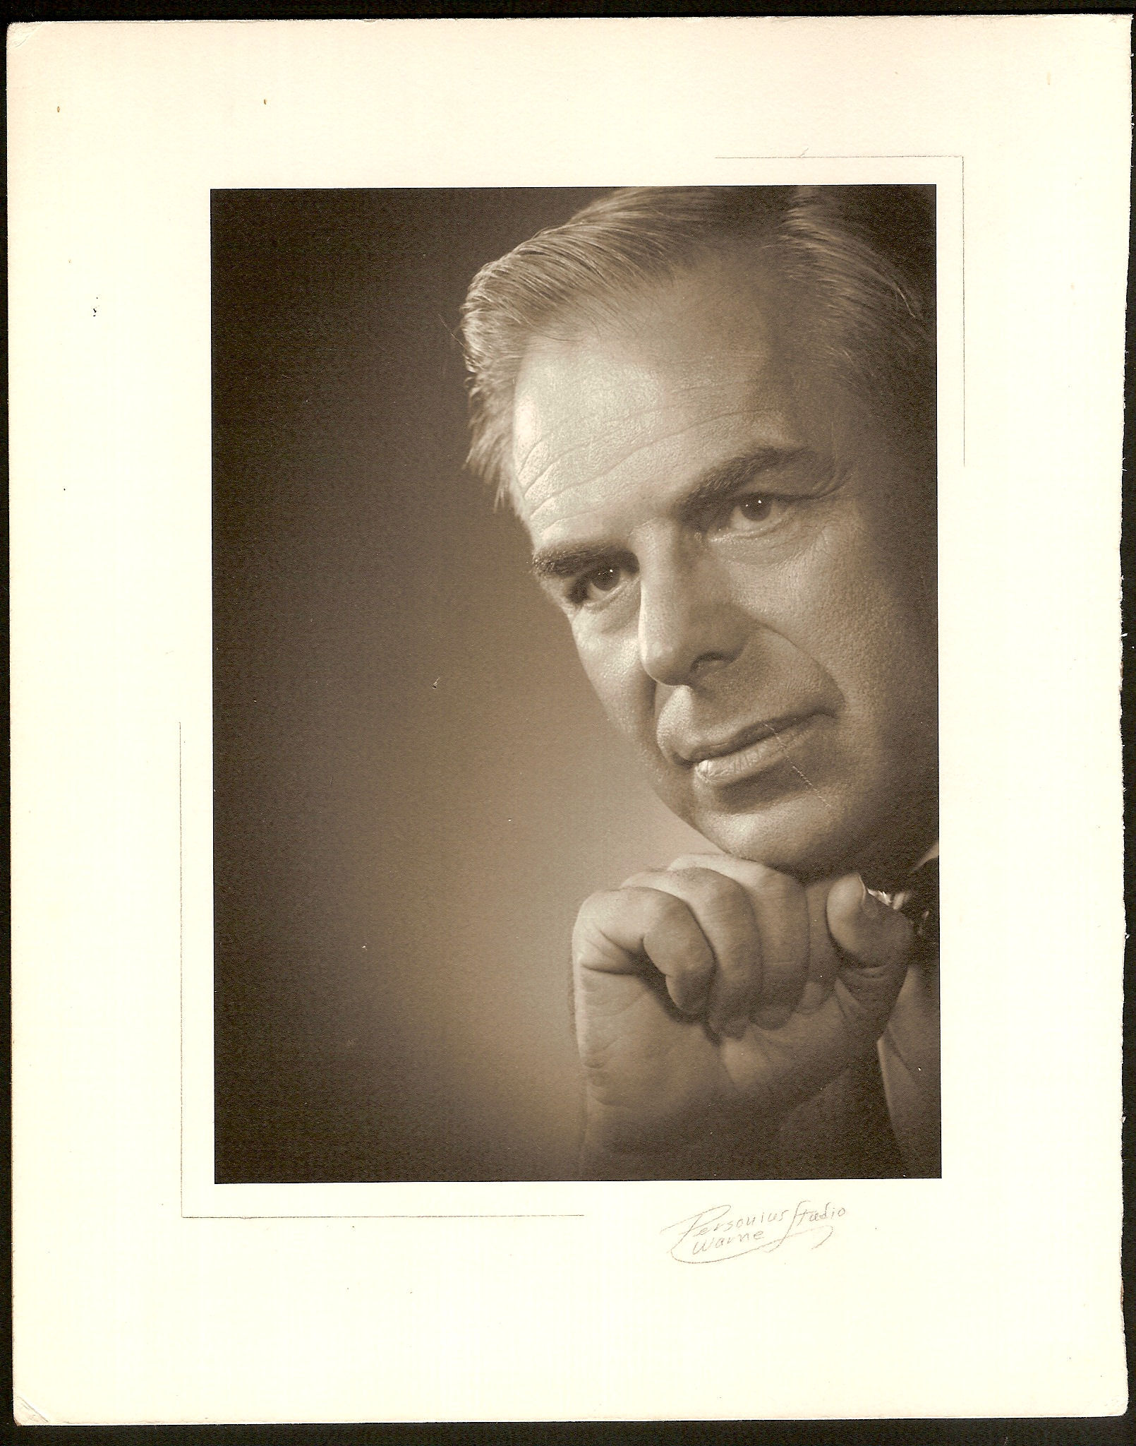

Slide 36
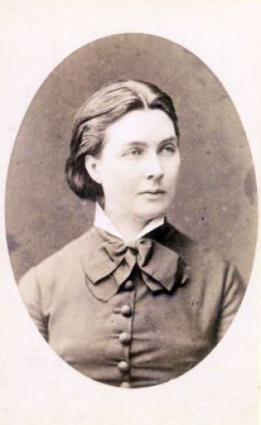
Marie Schumann Personius Namesake - Marie Schumann the Daughter of Robert and Clara
Marie Schumann

Slide 37
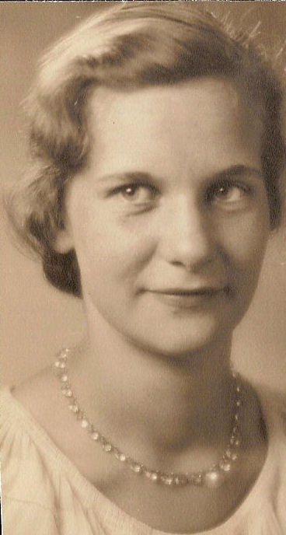
Marie Schumann Personius

Slide 38
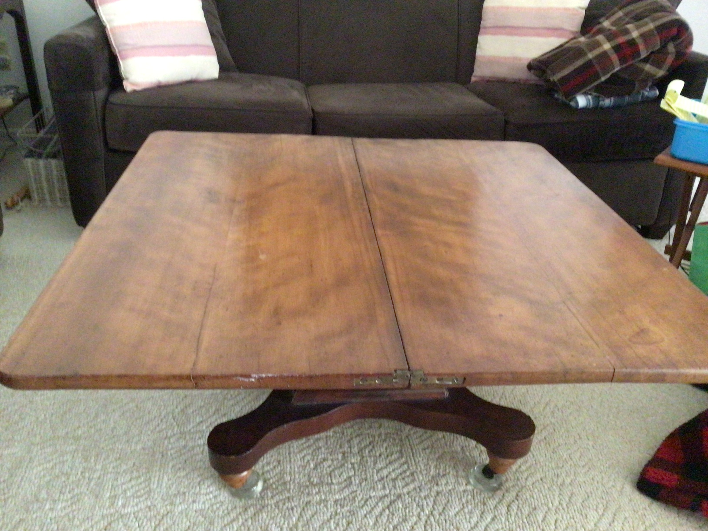

Slide 39
